Slide 1


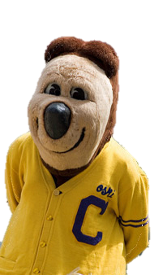

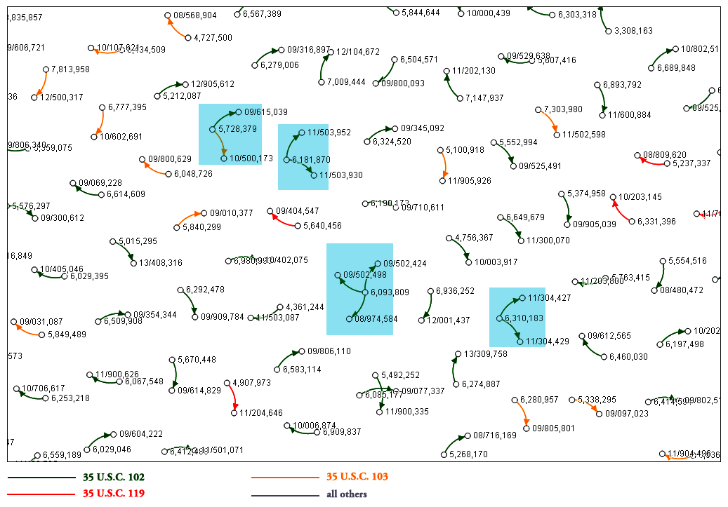

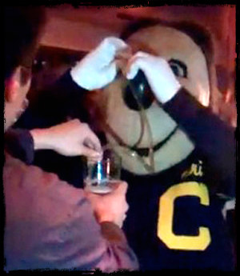


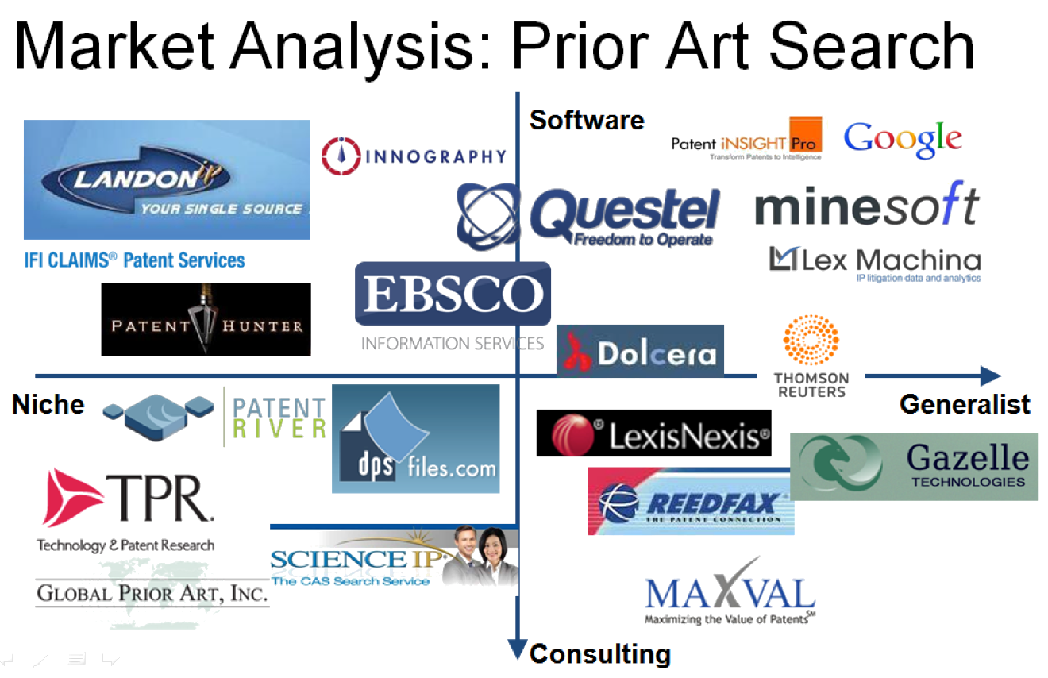




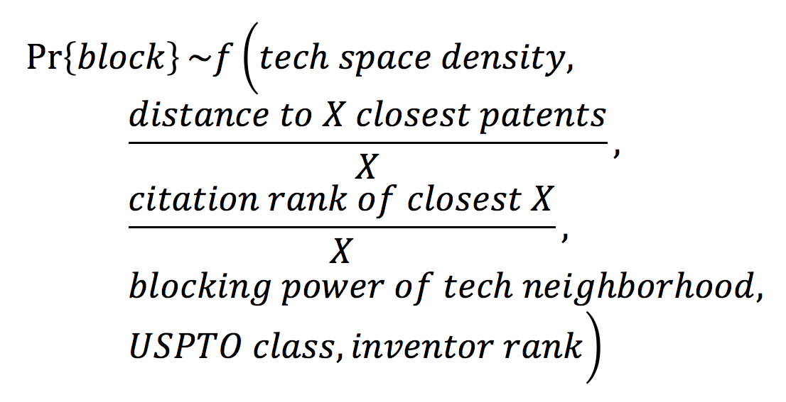
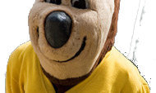
Big Data: Business Models and Open Innovation
Vincent Sheu, Shangpo Chou, Raphael Merx, Juan Sanchez, and Yvan Naoussi
Meet Oski!
Our Proposed Applications
Our Technology
Success!
+
Minimize
Pr{Oski patent is blocked} &
Produce useful reports
=
Patent?
Recommend changes!
Blocking map: Building a map of patents that have blocked applications and/or cited by other applications, patents, and USPTO rulings.
Cluster analysis
Machine Learning
Oski Patent
Compare against 5 million patents!
Visualize!
Visualization: Graph technology space using the Jaccard index, LASSO algorithm and tagging matrix:
Dimensionality reduction: Reduce tagging matrix to visualize in 3 dimensions.
Big Data analysis
Find similar patents
Oof. Well, that’s not good.
From the monoliths (Google) to the startups (Gazelle Technologies), rejection reports (Patent River) to cradle-to-grave patent lifecycle management (Maxval), everyone seems to want a piece of this market!
Undeterred, Oski comes back to Berkeley to ask: how can Berkeley help me?
Tag!
Extract differentiating words
Tagging: Developing a set of words that describes and differentiates each patent
e.g.
Patent # 6666650: yarn static counterpressure tangent verticl minu impedi …
Upload!
Future Directions
Train predictive model: Choose optimal machine learning model to accurately predict an application’s approval likelihood
Build optimization model: Apply optimization to suggest changes in patent application
Cluster analysis: use statistical techniques (K-Means, EM algorithm) to cluster similar patents according to tags
Predictive Model details
Predictive Factor Determination: Via regression modeling, exploring factors correlated with application approval/rejection and patent citation/blocking
Hypothesis:
Proposed training models:
Logistic regression or GLM
Support Vector Machines (SVM)
K-NN
Random Forest
Naïve Bayes
Acknowledgements
Scientific Advisory Board David Kappos, former Director of the USPTO
Stu Graham, former Chief Economist at the USPTO
Jeff Oldham, head of the patent group at Google
Industry advisor Matt Rappaport, CEO of IP Checkups
Fung Institute Patent Lab Prof. Lee Fleming
Gabe Fierro
Guan Cheng Lee

